Slide 3
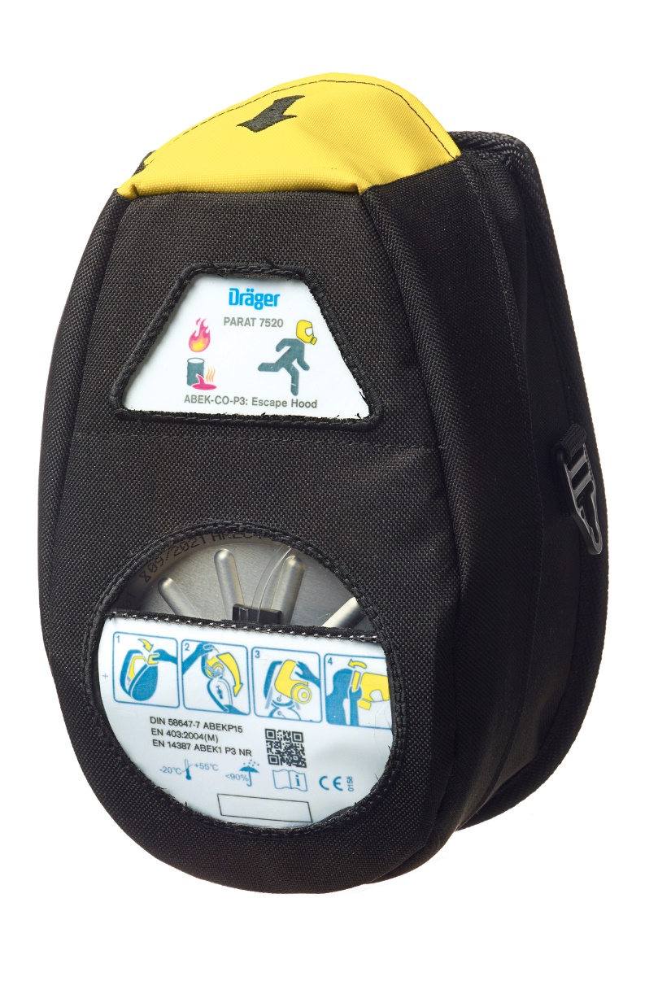
Dräger PARAT® Escape Hoods
In an emergency situation, there is no time to spare. Users don‘t have time to read lengthy instruction manuals for their equipment. An escape hood, especially, must be fast and easy to use.
Dräger PARAT® Escape hoods were developed in cooperation with users – always with the focus on the fastest possible escape.
Optimized operation and wearing comfort, a robust housing and tested filters guarantee that the wearer of the Dräger PARAT® is protected from toxic industrial and fire-related gasses, vapours and particles for at least 15 minutes.

Slide 4
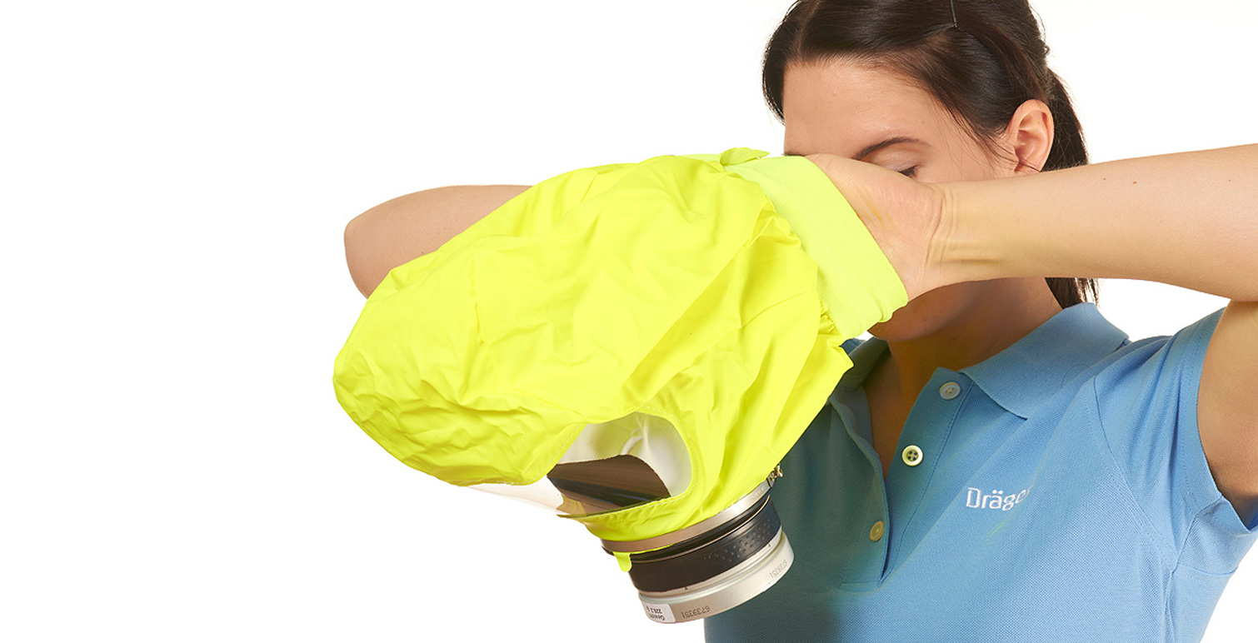
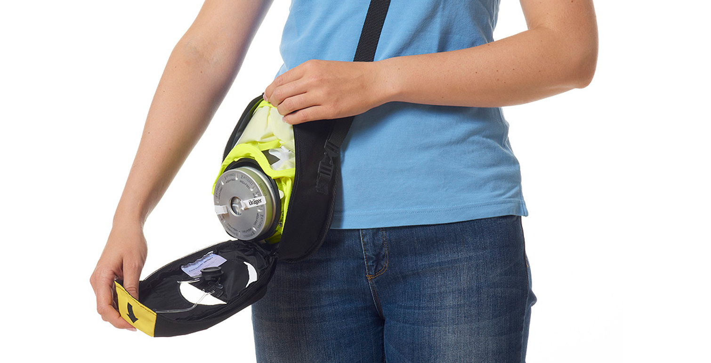
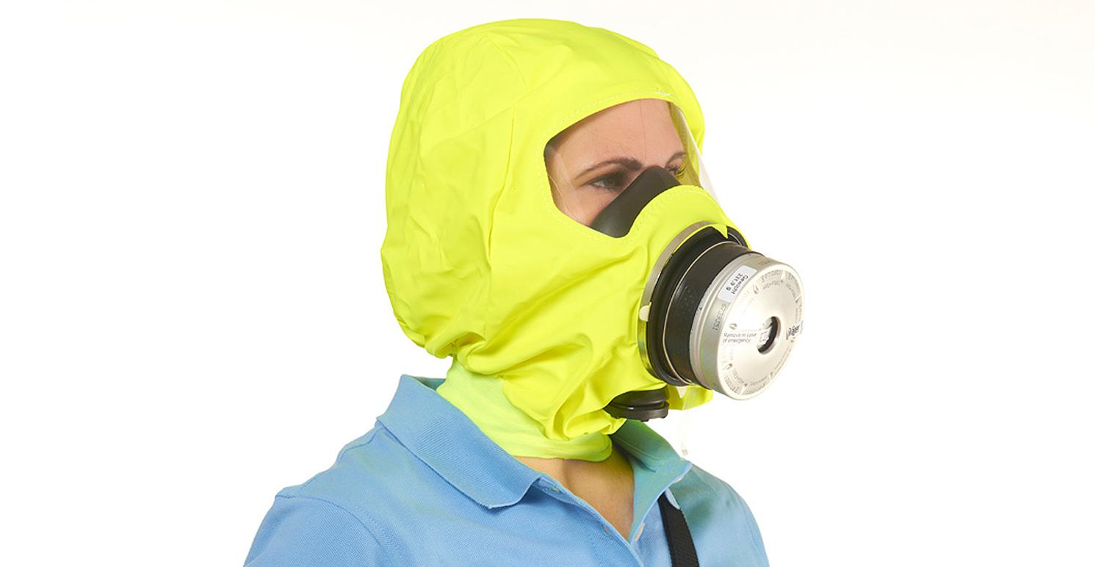
Dräger PARAT® Ready for escape in only three steps
STEP 1
OPEN
STEP 1
OPEN
STEP 2
DON
STEP 2
DON
STEP 3
RUN
STEP 3
RUN
Due to the integrated head harness, the handling is particularly simple and fast.
The internal head harness automatically adjusts when the hood is donned and the hood fits the head shape.
One hood size fits for all head sizes.
Due to a new mechanism the filter sealing plugs are automatically removed when the packaging is opened.
When opened the filter deploys automatically and the hood can be immediately donned.
The filters reliably protect the user from a wide range of toxic industrial and fire-related gasses, vapours and particles.
The specially designed, anti-fog coated visor provides a clear view during an escape.
Bitte neuen Text prüfen!
vorher: Ein weites Blickfeld durch
das speziell geformte Visier
mit Antibeschlag-Beschichtung
Notes:
1aOriginal: Wird die Verpackung geöffnet, löst sich der Filterstopfen automatisch aus dem Filter
englisch:Due to a new mechanism the filter sealing plugs are automatically removed when the packaging is opened
1bOriginal: Dabei wird der Filter in seine Einsatzposition herausgedrückt und die Haube kann sofort angelegt werden
englisch:SJ: When opened the filter deploys automatically and the hood can be immediately donned
2aOriginal: Dank elastischer Innen-Bänderung ist kein zusätzliches Festziehen notwendig
englisch:Due to the integrated head harness, the handling is particularly simple and fast
2bOriginal: Die Haube, passend für alle Kopfgrößen, passt sich automatischder Kopfform an
englisch:The internal head harness automatically adjusts when the hood is donned and the hood fits the head shape. One hood size fits for all head sizes.
3aOriginal: Die Filter schützen zuverlässig vor einem breiten Spektrum an toxischen Industrie- und Brandgasen, Dämpfen und Partikeln
englisch:The filters reliably protect from a wide range of toxic industrial and fire-related gases, vapours and particles (PI Abschnitt: Reliable Protection)
3bOriginal: Das speziell geformte Visier mit Antibeschlag-Beschichtung ermöglich eine gute Sicht und ein weites Blickfeld
englisch: wide, antifog coated visor for a clear view during an escape (übernommen aus PI engl für Parat 4500)

Slide 5
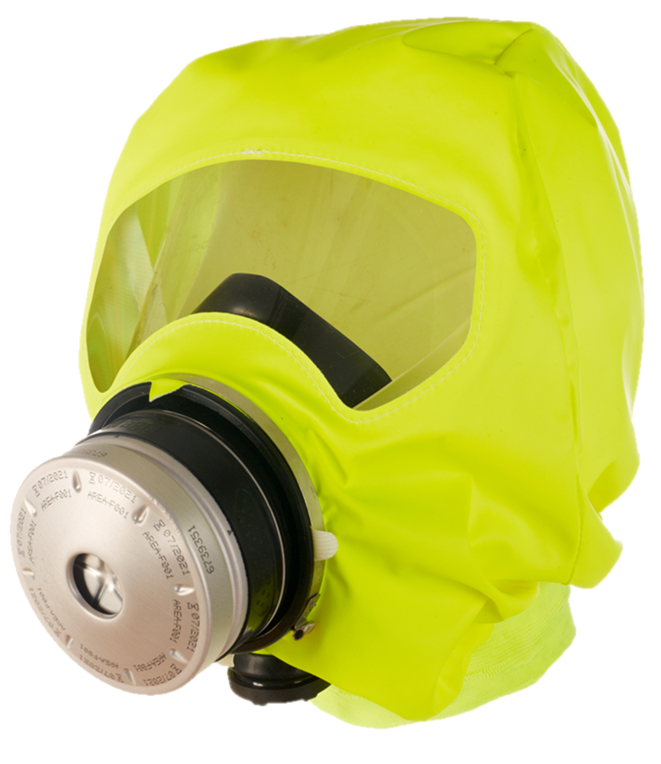
Dräger PARAT® at a glance.
Clearly visible hood
Hood in signal colour for high visibility
Overall protection
16 years of total service life (provided the filter is exchanged after 8 years.), Hood provides respiratory and eye protection
Internal head harness
Thanks to the automatically adjusting internal head harness, no additional tightening of the hood is required.
Clear view
Wide field of vision due to a specially formed visor. Always a clear view thanks to a special anti-fog coating
High-performance filter
Filter expiration date is clearly marked; the filter is automatically released from the packaging when opened.
Good fit
Specially designed half mask fits a wide variety of face sizes
Textile neck seal
Exhalation valve
Directly leads the exhaled air out of the half mask
Replacing the filter after 8 years will extend the service life of the Dräger PARAT Escape Hood to 16 years in total.

Slide 6
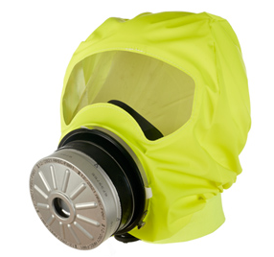

Dräger PARAT 7500
FIRE & INDUSTRIAL ESCAPE HOOD
DRÄGER PARAT 7500
Use
protection against toxic industrial gasses, vapours, particles and fire-related gasses
Filter
ABEK CO P3 Filter
Approval
according to EN 403:2004 for fire escape hoods;
according to DIN 58647-7 for filtering escape devices;
filter additionally tested in accordance with EN 14387:2004 for gas filter (s) and combined filter (s)
Packaging types
available in Hard Case and Soft Pack
Carrying options
various carrying options
Notes:
various carrying options →Original: vielfältige Trageoptionen
All hoods are available as training hoods →Original: Alle Hauben sind auch als Trainingshauben erhältlich

Slide 7
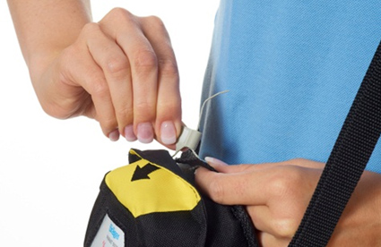
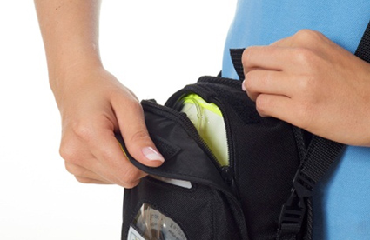
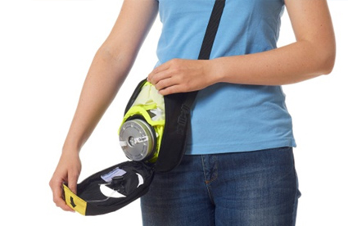
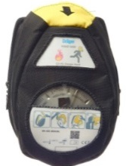
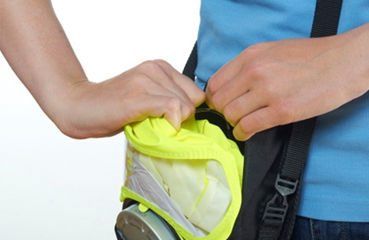
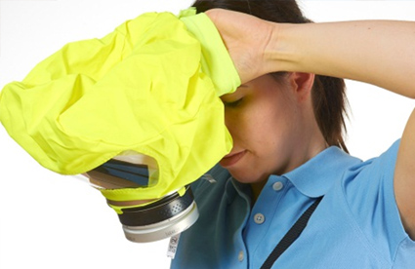
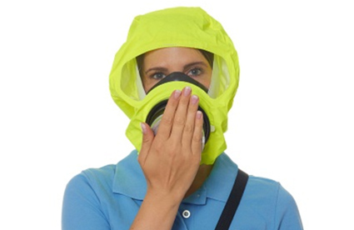
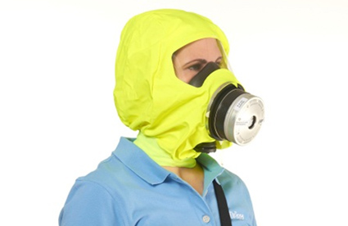
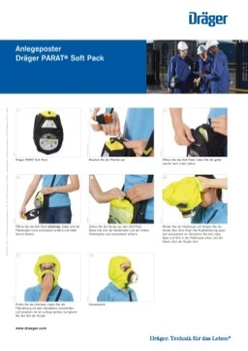

Donning Soft Pack
Dräger PARAT® Soft Pack
Break the security seal.
Pull the yellow flap downwards.
Open the soft pack completely. The front filter sealing plug should be automatically removed.
.
Remove the hood from the Soft Pack. Pull the hood against the Velcro holder, it will automatically open. The second filter sealing plug will automatically be detached when the hood is removed.
Widen the neck seal and pull the hood over your head. The inner head harness automatically adjusts to your head. Ensure that nose and chin sit comfortably in the half mask and that all hair is tucked into the hood.
Check the fit of the half mask by closing the front filtering opening with the palm of your hand. If negative pressure is not generated readjust the half
mask to ensure a close fit over nose and mouth.
.
Ready for use.
Video on
Donning poster
order code: 9094201
http://www.youtube.com/watch?v=DMtHs_h5VAg&feature=youtu.be

Slide 8
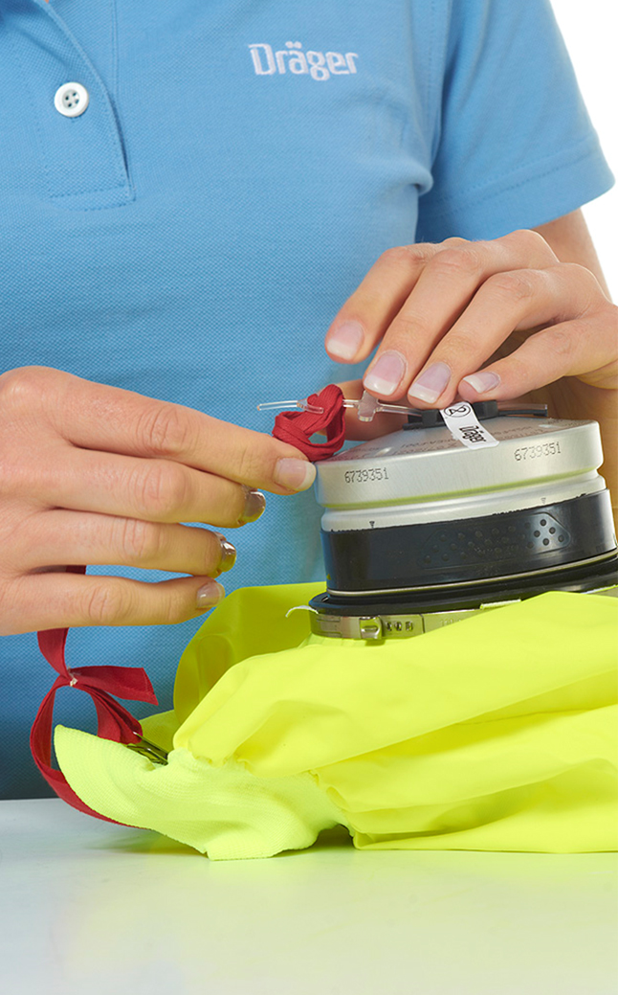

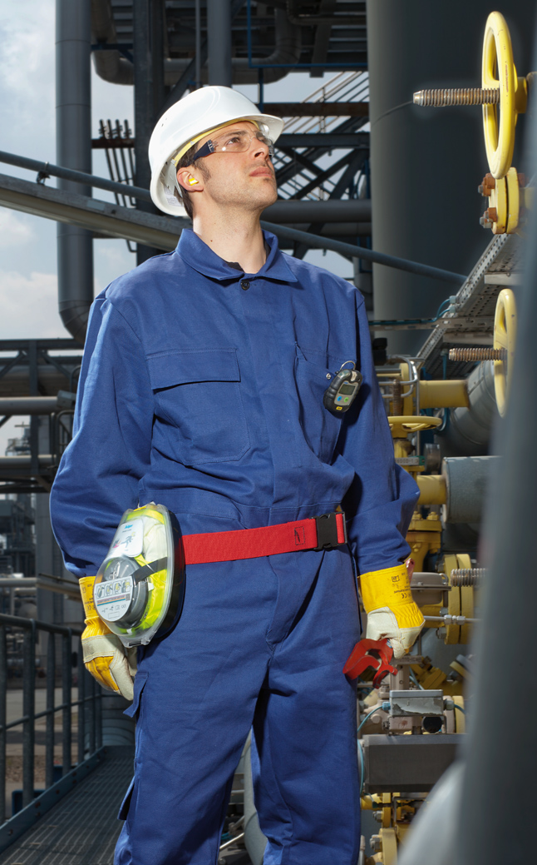
Filter replacement
The window on the Soft Pack and Hard Case packaging allows the easy control of the filter expiration date.
Replacing the filter after 8 years extends the service life of the Dräger PARAT Escape Hood to 16 years in total.
For this, Dräger offers filter replacement service or an expert training for your employees.
In the long term, this offers you great cost savings.
Take a look at the respective instructions on our
youtube channel:
http://www.youtube.com/user/draeger

Slide 9
Dräger PARAT 7500 use in wildfire vehicle overrun scenario

Slide 10
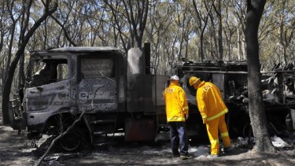
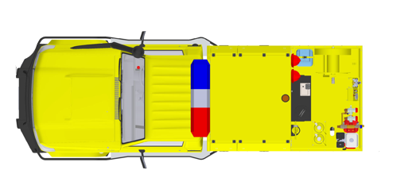


When to deploy Dräger PARAT 7500
Scenario 1 – Vehicle Fire Overrun
Vehicle Impacted by embers and then direct flame.
Crew send Emergency Radio message deploy their Dräger PARAT 7500 while sheltering in the vehicle for shelter during flame impact.
Crew is protected from the potential for the materials of the vehicle that would off gas while being impacted by the fire
Once the fire has passed the vehicle the crew can leave the vehicle while wearing the Dräger PARAT 7500 protecting them from CO and protection from smoke from the burning vehicle.

Slide 11
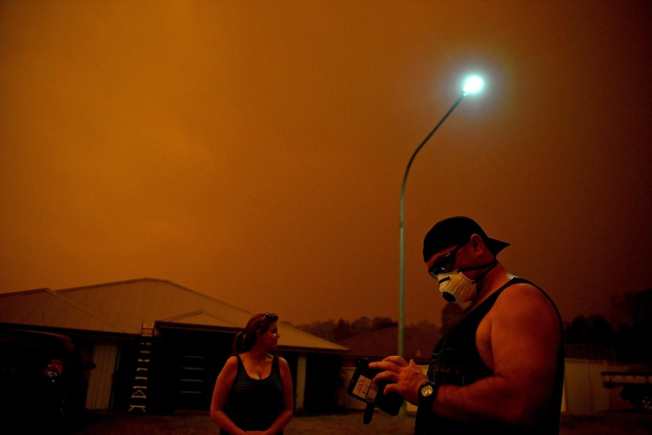
When to deploy Dräger PARAT 7500
Scenario 2 – Protecting Vulnerable People
Dräger PARAT 7500 could be deployed to support vulnerable people who are affected by heavy smoke due to the bushfires impacting on communities .
This could be deployed for people with respiratory conditions such as asthma providing them protection against the particulates and the gasses within the smoke

Slide 12
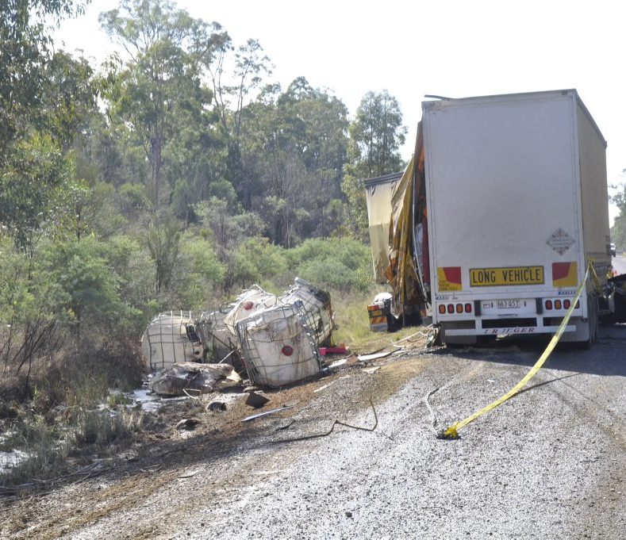
When to deploy Dräger PARAT 7500
Scenario 3 – Chemical Spills
It's not uncommon for Rural Fire Brigades to be called to unknown incidents to later find that there are chemical spills or incidents with unknown hazardous substances.
The Dräger PARAT 7500 could be deployed to protect the firefighter from the effects of the chemicals while they are returning to a safe place some distance away from the incident.

Slide 13
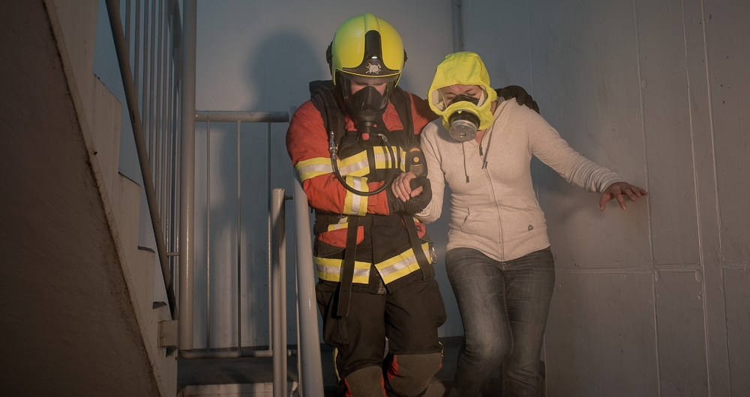
When to deploy Dräger PARAT 7500
Scenario 4 – Building evacuation
PARAT 7500
When every second counts
A fire fighter must always be ready to rescue and able to protect victims from fire-related gases. The PARAT 5550 is approved to be carried directly on the breathing apparatus. So an escape hood is always available. Additionally there are pockets for other utensils like wedges and loops which can come in handy in an emergency situation.

Slide 14
Dräger Escape Hoods
Standards

Slide 15
Dräger PARAT Escape Hoods
Standards EN 403:2004
European standard for: Respiratory protective devices for self-rescue, filtering devices with hood for escape from fire”
This European standard is valid for hooded filtering escape devices for the individual escaping from particles, carbon monoxide and other fire-related gasses.
The standard defines the minimal requirements for an escape unit (e.g. min. 15 minutes of escape time), the scope of its purpose (e.g. definition as single use only) and describes the required tests and markings.
This standard is not valid for escape devices, which can be used in case of oxygen deficiency → O₂ concentration >17%
Criteria for test gas and breakthrough concentration
Test Gas | Test Gas Concentration (ppm) | Breakthrough Concentration (ppm)
Acrolein | 100 | 0.5
Hydrogen Chloride (HCI) | 1,000 | 5
Hydrogen Cyanide (HCN) | 400 | 10
Carbon Monoxide (CO) | 2,500 | 200
Carbon Monoxide (CO) | 7,500 | 200
Carbon Monoxide (CO) | 5,000 | 200
Carbon Monoxide (CO) | 10,000 | 200

Slide 16
Dräger PARAT Escape Hoods
Standards DIN 58647-7
German standard for:“ Respiratory protective devices for self rescue, part 7: Filtering escape devices“
This standard sets the minimum requirements for filtering escape devices for personal escape from industrial gasses, vapours &/or particles for one time use
This standard is not valid for escape devices which can be used in the case of an oxygen deficiency → O₂ concentration >17% or for devices which protect against CO
Criteria for test gas and breakthrough concentration
Test Gas | Test Gas Concentration (ppm) | Breakthrough Concentration (ppm)
Cyclohexane (C₆H₁₂) | 2,500 | 10
Chlorine (Cl₂) | 2,500 | 0.5
Hydrogen Sulphide (H₂S) | 2,500 | 10
Hydrogen Cyanide (HCN) | 2,500 | 10
Sulphur Dioxide (SO₂) | 2,500 | 5
Ammonia (NH₃) | 2,500 | 25
Hydrogen Sulphide (H₂S) | 10,000* | 20
* To determine the breakthrough capacity of the gas filter it is additionally tested with 10,000 ppm hydrogen sulphide.

Slide 17
Dräger Video Links
Testimonial PARAT Escape Hood : https://youtu.be/w9khPkyyxp0
Third-party rescue with PARAT 7500: https://youtu.be/7FRIFqkjXk0
Dräger PARAT Training Hood: https://youtu.be/cyUNKBFFO94
Dräger PARAT Soft Pack - Speed Contest: https://youtu.be/MsitcuR-rwI

Slide 18
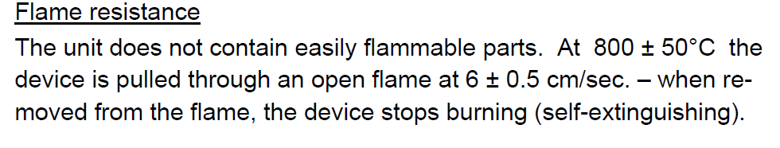
Dräger PARAT 7520
Flame Resistance
Taken From:
Technical Data Sheet
Dräger PARAT 7500 Fire and Industrial Escape Hood

Slide 19
Dräger PARAT 7520
Part number Information
02

Slide 20
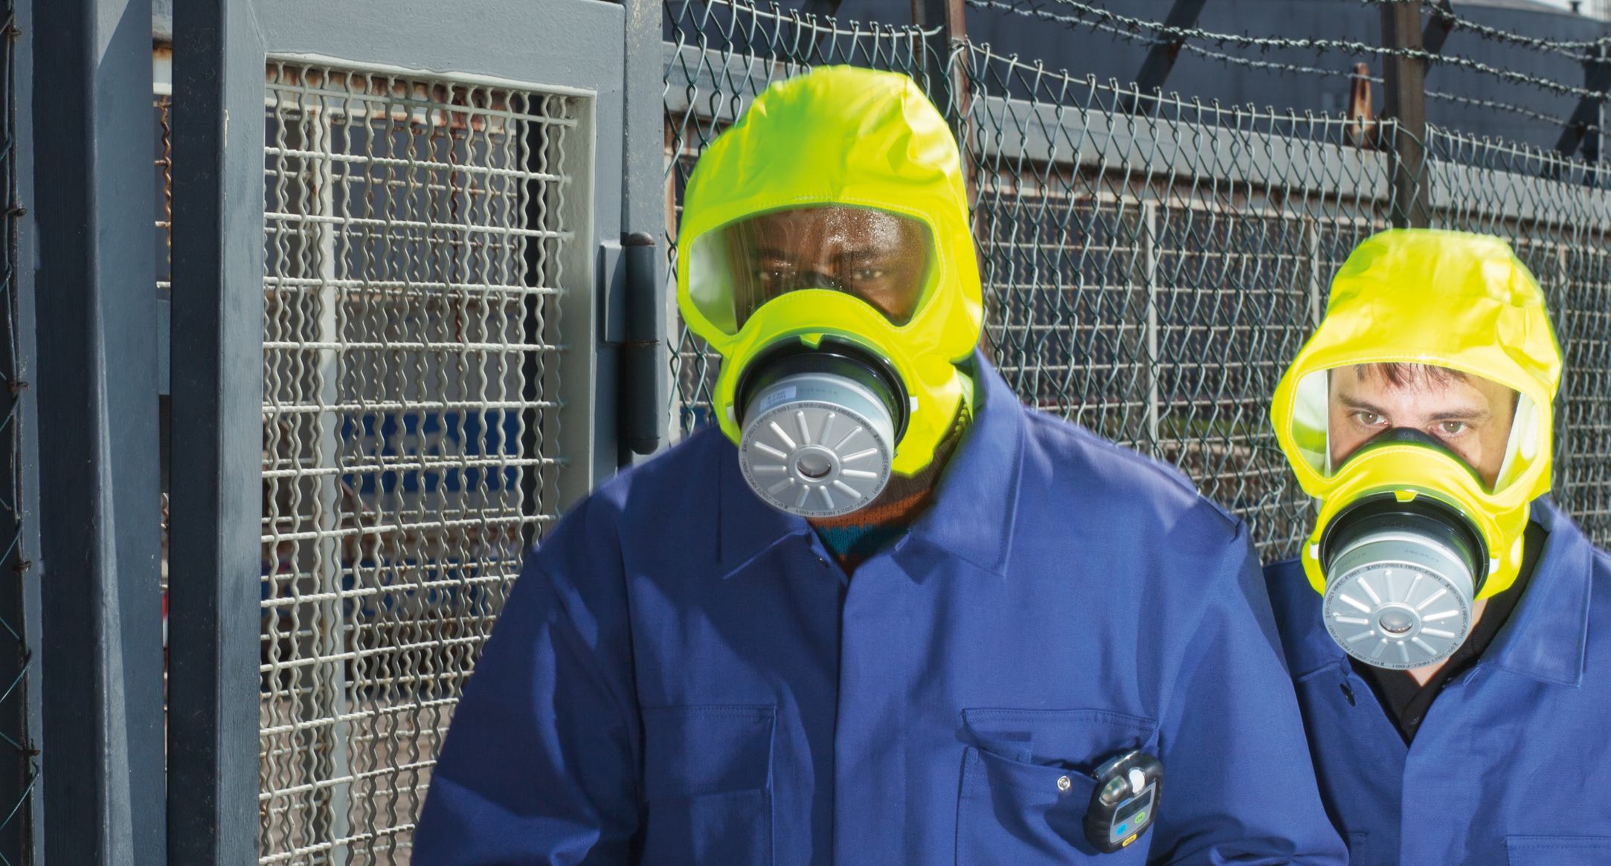
Ordering Information

Slide 21

Overview Order Codes
Fire and Industrial Escape Hoods
Industrial and Fire Escape Filter ABEK CO P3
 | Description | Packaging | Order Code
 | Dräger PARAT 7520 | Soft Pack | R 59 427
 | Replacement Filter Set: Dräger PARAT 7500 (incl. ABEK CO P3 filter and security seal) |  | R 59 477

Slide 22
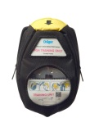
Overview Order Codes
Training Hoods
 | Description | Packaging | Order Code
 | Dräger PARAT Training Hood | Soft Pack | R 59 420
 | Spare Part Set: 20 filter plug straps | – | R 59 482
 | Spare Part Set: security seal (white) 10 pcs. | – | R 59 484
Especially for training purposes:
Hood contains a filter dummy.

Slide 23

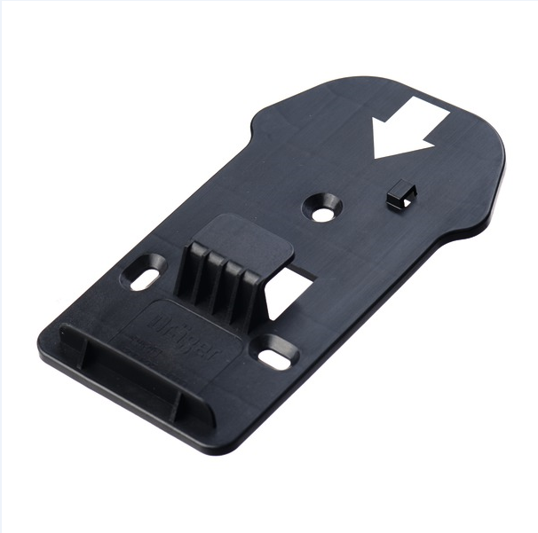
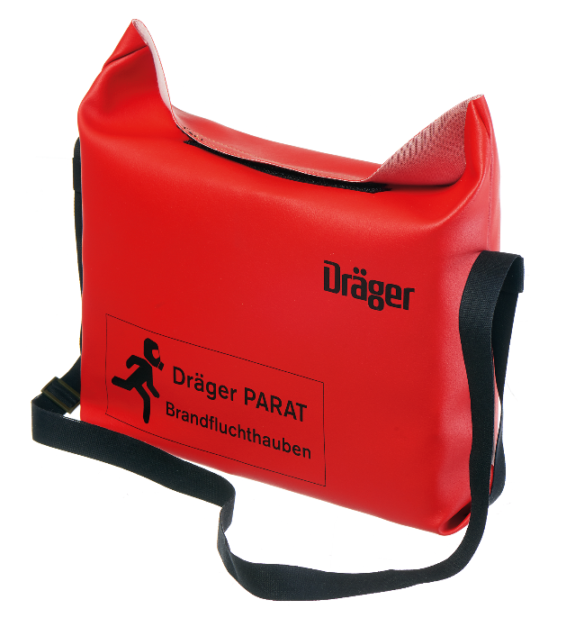
Overview Order Codes
Carrying options for PARAT Escape Hoods (exc. PARAT 5550)
 | Description | Order Code
 | Wallholder (PARAT Hard Case) PIN | R 59 451
 | Wallholder (PARAT Hard Case) HOOK | R 59 452
 | Carrying bag for PARAT 5510 | R 51 907

